Slide 1

Working Capital Management
Order to Cash – Technique Paper
The full scope of Cash and Working Capital Management (CWCM) services is not permissible for SEC audit clients and their affiliates or IFAC PIE audit clients and their related parties. CWCM services are generally permissible for IFAC non-PIE audit clients subject to evaluating engagement circumstances using the conceptual framework (i.e. threats and safeguards approach) and provided we do not assume a management responsibility as outlined in the Global Quality & Risk Management Manual Chapter 11. See detailed guidance regarding Independence on slides 11-16 of the CWCM methodology guide.
RESTRUCTURING
August 2008
ADVISORY
For the purpose of this document, all references to KPMG International, a Swiss cooperative that serves as a coordinating entity for a network of independent member firms operating under the KPMG name, will be referenced as KPMG International. Throughout this document, "KPMG" ["we," "our," and "us"] refers to the local, independent KPMG member firm or firms. Throughout this document “client” [“they,” “their and “them”] refers to the local, independent member firm’s client. KPMG International provides no client services.

Slide 2
Introduction
  Title of Document: Order to Cash Technique Paper
  Purpose of this document
  This technique paper covers the key processes and identifies main improvement areas within the Order to Cash (OTC) cycle, as well as identifying tools and example tests. The tools comprise of: Data request, Guidance on holding workshop’s, Leading Practices, Diagnostic Questions, Suggested data analysis, Guidance on reporting and recommendations. For the Data request, Leading Practices and Diagnostic Questions, please refer to the Cash and Working Capital Management Microweb (click here).
When and how to use this document: These tools and tests can be used by practitioners when conducting the data analysis during a OTC diagnostic within the Assess phase of a Cash and Working Capital Management (C&WCM) engagement, to identify working capital opportunities. Please refer to the Cash and Working Capital Management Method Guide for the activities, tools and templates used in this phase.

Slide 3
Contents
Topics Covered Slide Number
Section 1: Working capital overview and example approaches Slide 3
Section 2: Order to Cash overview Slide 7
Section 3: Diagnostic Data Analysis Slide 16
Appendix: Overview of Approach for Release of Working Capital Opportunities Slide 80

Slide 4
Section 1
Working capital overview

Slide 5
Working capital processes
  Three key processes comprise working capital as follows:
Component
Process
Key processes
Order to cash
(OTC)
  Customer acceptance
  Sales management
  Credit risk management
  Order management and invoicing
  Collection
  Dispute management
  Cash allocation
Revenue management
  Planning
  Sourcing
  Making
  Deliver and return
Working Capital
Inventory
management
Forecast to deliver
(FTD)
Expenditure management
Purchase to pay
(P2P)
  Procurement strategy
  Supplier selection and contracting
  Requisition order management
  Receiving and supplier management
  Discrepancy management
  Invoice processing and payment management

Slide 6
Diagnostic Analysis Approaches
  To be able to identify Working Capital Opportunities, we aim to perform a detailed Diagnostic Analysis with the client. However, there may be a requirement to undertake a ‘lighter touch’ analysis ahead of performing the detailed Diagnostic Analysis. This may comprise either: a Desktop Assessment, or a Quick Assessment. The differences in each approach are summarised below:
It is recommended to undertake a detailed Diagnostic Analysis instead of these steps
 | Desktop Assessment | Rapid Assessment | Detailed Diagnostic Analysis
Key people | Sponsor, Controllers | Sponsor, Controllers, Main Director Level Managers | All key people in organisation supporting WC processes
Objectives | Provides a very high level analysis and understanding of opportunities Should support the case for a detailed Diagnostic Analysis | To review and provide direction on which areas need to be included in Diagnostic phase To get buy in from local management and key decision makers for detailed Diagnostic Analysis | Identify and quantify opportunities to release cash from working capital
Activities | Remote, data driven analysis High level questionnaires Validation of findings | High level process interviews with key people Data Analysis Validation of findings | Workshops Detailed process interviews Define detailed gap assessment between leading practices and identifies opportunities
Duration | 1 to 10 days depending on client complexity, number of location involved and client resource commitment | On site typically 2-3 days per capability (OTC, P2P, FTD) or country/business depending on client complexity | On site typically 3-6 weeks per capability (OTC, P2P, FTD) depending on client complexity
Outcome | List of high level opportunities identified from questionnaires | List of high level opportunities High level process gap assessment and data analysis Insights on possible actions to improve current performances. Actions and benefits to be validated more in detail during detailed diagnostic phase | Detailed list of opportunities, with value, difficulty grid and related project plan Detailed report on findings opportunities Detailed list of process gaps

Slide 7
Order to cash
Suggested approach for a Detailed Diagnostic Analysis
Our approach
  Our approach will vary depending on the scope of work we will undertake. For a full diagnostic review of the OTC process, we would typically:
Example timetable | Action | Who is involved from the client side?
Pre-field work | Submit data request and gather data | CFO/AR Manager and IT
Day 1 to 2 | Overview of Order to Cash process Review AR ledgers to identify any issues | CFO/AR Manager
Day 3 to 4 | End to end workshop to understand process and peoples’ roles and responsibilities | Sales Finance and A/R Distribution Legal
Day 5 to 11 | Detailed questions to each senior person in cycle Review current reporting and monitoring Detailed analysis to provide observations and recommendations | Sales Finance and A/R Distribution Legal
Day 12 to 13 | Prepare for workshop End to end workshop to confirm observations and recommendations and assist client management in shaping potential solutions | Sales Finance and A/R Distribution Legal
Day 14 to 15 | Consolidate and report findings Recommend next steps | KPMG/Senior management

Slide 8
Section 2
Order to cash management overview

Slide 9
Order to Cash
Introduction
What processes are involved?
  Customer acceptance
  Sales management
  Credit risk management
  Order management and invoicing
  Collection
  Dispute management
  Cash allocation
What departments are involved?
  Sales / account managers
  Finance (inc. order processing)
  Distribution
  Legal
What are the overall objectives?
  Our overall objectives are to understand:
    What are the goals and objectives of those involved in the OTC process?
    What policies exist to govern behaviour across the OTC process?
    What cash release opportunities may exist in the OTC process?
  We want to:
    Help ensure cash flow is optimised and the cash impact of decisions is monitored throughout the whole process and across disciplines
    Provide management with an understanding of the trade off between current working capital employed and financial cost of working capital
    To raise awareness across the organisation of the importance of cash management
    Enable management to assess the possible impact of future strategies on free cash flow and costs
  In our experience optimising working capital helps improve effectiveness, lowers operating costs and improves service levels.
What are the process objectives?
  Defined roles and responsibilities within the end to end process
  Optimised invoicing cycle with an efficient end to end process
  More accurate and timely invoicing system
  Development of detailed credit control procedures and manuals
  Introduction of a proactive collection strategy
  Development and setting of collection targets
  Implementation of an effective dispute management process
  Reduced number of disputes/complaint and improved customer service
  Root cause analysis of queries
  Pro-active customer management
  On going review of end to end customer profitability
  Improved management reporting and key performance indicators
  Clean / tidy ledgers allow for more confident receivables collections
  Reduced level of overdue debts and improved cash flows
  Improved credit risk profile of the customer base

Slide 10
Order to Cash
Introduction (cont.)
We will need to ascertain:
  The current strategy, goals and objectives within the sales function for obtaining/monitoring/supplying customers.
  How the company formally controls and manages customers including:
    Customer acceptance
    Term and contract management
    Order processing
    Invoicing
    Dispute management
    Collection
    Reporting and account reconciliation
Typical Benefits
  Improve cash flow by:
    Accelerating invoicing where possible
    Improving accuracy of invoicing
    Reducing disputes and write-offs
    Reducing bad debts
    Reducing terms
    Pro-active collection
    Efficient collection methods eg direct bank transfer
    Getting customers to pay on or close to terms
  Improve profitability by:
    Reducing bad debts
    Reducing price reductions and write-offs due to disputes
    Reducing staff numbers and handling costs
Key actions and outcome
  In the short term collect overdue accounts as quickly as possible
  In the medium to long term, modify and streamline the end to end process to eliminate bottlenecks and blockages that cause delays in the process
  Help ensure all functions are engaged in the process and aware of the consequences of their actions

Slide 11
Order to Cash
Order to Cash – process map for existing customers
Sales
management
Credit risk
management
Order
management
and invoicing
Collection
Dispute
management
Cash
allocation
Sales
Negotiation
Credit Check
Dispute
management
process
Customer
registration
Ongoing Credit
Monitoring
Order entry
Product or
service delivery
Collection of
additional information
Invoice
Production
& printing
Collections
process
Customer
payment
Cash
allocation

Slide 12
Order to Cash
Key processes and main improvement areas
Customer acceptance
Sales
management
Credit risk management
Order
management and invoicing
Collection
Dispute management
Cash allocation
Credit account request form | Quote management process | Customer risk assessment | Order entry | Customer collection strategy | Dispute identification | Cash posting
Credit and other checks | Payment methods and terms | Credit limit management | Customer service | Cash targets | Dispute resolution | Unallocated cash
Contract approval | Contracts management | Pre and post-order credit assessment | Order fulfilment | Defined dunning processes | Credit note processing | Ledger reconciliation
Customer account set-up | Customer profitability | Ongoing risk monitoring | Invoicing triggers and production | Customer stop | Root cause eradication | Account reconciliation
 | Sales force incentive structures | Customer masterfile management | Deductions management | Litigation strategy
 |  |  | Invoice calculation and verification | Bad debt and write- offs
 |  |  | Exceptional invoicing

Slide 13
Order to cash
Processes – key issues
Customer Acceptance
Sales management
Credit Account Request Form None completed Incomplete data with no billing details and no record of company history, directors, bank and other references No detailed forecast of weekly/monthly/annual supply requirements Request form does not capture data required for customer account set-up Credit and other checks None undertaken Not undertaken before supply starts Conclusions from checks overridden by sales department Contract Approval Inappropriate authority levels for sign-off No contract signed before supply commences Unauthorised changes to terms/discounts to close the deal No formal process for capturing contract variations Legal and finance do not sign off key contractual terms including credit limits and terms Customer account set-up Account opened with details missing eg: billing address, credit limit and payment terms Pricing file deviates from standard pricing | Quote management process Sales can negotiate and adjust payment terms on specific orders Inefficient price amendment communication process No consideration/assessment of working capital impact of changing terms Payment methods and terms No clear indication of payment method to be used for specific customer segments Similar customers have different payment terms and payment methods Lack of accountability for changes in terms and payment method How frequently are terms and conditions renegotiated? Customers may have different payment terms for different products or across different divisions Customer profitability Customer profitability not used to determine customer management strategies Company does not monitor customer profitability Contracts definition and management Variations to contracts are not managed giving rise to disputes at a later stage Revenue capture may be incomplete Contract documentation is poor Sales force incentives structures Sales bonus only based on sales turnover and margin A lack of cooperation between sales and credit control and/or customer service Sales stop credit control from contacting customers or putting them on stop Sales commissions paid on anticipated annual turnover

Slide 14
Order to cash
Processes – key issues
Credit risk management
Order management and invoicing
Customer risk assessment No use of external agencies or previous history in assessing customer risk Company may be over-exposed to certain customer types or industry sectors increasing bad debt risk Is credit insurance used or required? Credit limit management No use of external agencies in setting credit limits Conservative credit limits: credit breaches are happening on less than 0.5 % of receivables continuously Too strict credit limit: credit breaches on more than 20% of receivables with no clear reason Although the business has high seasonality and irregular ordering patterns, the credit limit formula is still based on terms multiplied by a factor for daily sales Pre and post-order credit assessment Status of account not checked before despatch No clear procedures and roles to put customers on stop or delay despatch Lack of credit stop reports Ongoing risk monitoring No regular review of customer credit limits/payment performance No corporate level co-ordination of credit exposure Do cash receipt delays give false alarms? Are credit claims ignored by sales? Sales department override process Customer masterfile management No procedures to process amendments to terms, limits, billing addresses, etc. No frequent cross-checking between contract database and masterfile to help ensure current contract information is captured. | Order entry Delayed/inaccurate order capture Poor administration of back orders/substitution Lost sales not recorded No order acknowledgement process Customer service High volumes of complaints is a lead indicator of collection difficulties Order fulfilment High volume of differences between order and delivery information High volume of differences between delivery and invoice information Late deliveries High levels of product substitution Poor administration of delivery and return documentation Invoicing triggers and production Are there significant delays between despatch and invoice? Is invoicing an automated or manual process? How frequent are the invoicing runs (daily, weekly, monthly, specific date)? Deductions management Who can authorise deductions? Invoice calculation and verification Delayed/inaccurate invoicing Mismatch with customer’s payables process (eg PO’s not recorded etc) High number of credit notes Invoice sent to wrong office/department Exceptional invoicing Frequent one-off invoices/sales department interference

Slide 15
Order to cash
Processes – key issues
Collection
Dispute management
Cash allocation
Customer collection strategy Reactive approach to customer collection Poor customer prioritisation and contact tracking No segmentation of customers for collection procedures and approach. One collection procedure for all customers Credit control are restricted from contacting customers by sales or account managers Account management approach not utilised Cash targets No monthly/weekly/daily collection targets set for credit control department and individual collections DSO not measured Dunning (“Chasing”) process Ineffective or no use of dunning letters Inconsistent approach across different business types Delays in commencing process Customer stop No policy on when customers are placed on stop If a customer is placed on stop it is not communicated to sales/order acceptance teams Decisions can be overridden by sales Litigation No formal litigation strategy in place Do outsourced legal providers perform in accordance to service level agreements? What level of monitoring is available? Bad debts and write offs High level of write offs required to keep customers happy | Dispute identification Customers call credit control regarding disputes Information on disputes is often not available Disputes are raised primarily on overdue invoices Dispute resolution No formal dispute resolution process No defined common dispute codes No reporting on disputes Lack of formal open dispute reports No dispute escalation procedure formally in place No clear roles and responsibilities in dispute resolution There are disputes not assigned to controllers Credit note processing Delays in processing credit notes No reporting on the age of invoices to which credit note applies Credit notes cause invoices to be re-aged Root cause eradication Lack of analysis of root causes of dispute and therefore no eradication Common disputes occur over time with no reduction in frequency | Cash posting Labour intensive cash allocation process Low adoption of electronic payments Low receivables match rate Unallocated cash High levels of unallocated cash due to: Poor controls Lack of resource; or Missing customer information Unallocated cash can make credit control difficult as controllers chase debts which have already been paid Ledger reconciliations Sales ledgers are not reconciled to general ledgers Large levels of unreconciled differences Account reconciliations Major customer accounts are not reconciled to help ensure cash is posted to correct accounts Unallocated cash is not cleared and posted promptly

Slide 16
Order to Cash
Warning signs of issues in Order to Cash cycle
  Warning signs
  DSO higher than competitors
  Level of write-off > 0.2% of Sale
  Overdue debtors >15% of ledger
  Ratio of credit notes > 5% of total invoicing
  Customer profitability unknown
  Low customer retention
  Increasing exposure to certain customer segments
  Conflicts between Sales and Finance
  Unclear responsibilities with divided customer ownership
  High staff turnover with credit control and invoice processing
  High level of complaints, re-work and product substitution
  Sub-standard customer service
  Standard dispute resolution cycle time > 7 days
  No process to resolve root cause of discrepancies
  Increasing levels of staff turnover
  Worsening debtor days
  High levels of unallocated cash
  Growing volumes of bad and disputed debts
  Increasing levels of credit notes
  Worsening ageing profile
  Increasing volumes of unprocessed invoices
  Overstretched credit control function
  Increasing number of customers breaching their credit limits
  Increasing number of invoices raised containing errors
  Lack of working capital metrics and monitoring tools throughout the STC cycle
  Majority of disputed items are identified after invoice due date
  Disputes represent more than 5% of overdue balance
  High level of manual (non-system generated) invoicing
  Increasing or high level of manual activity in credit management
  Increasing or high cost of processing orders

Slide 17
Section 3
Diagnostic Data Analysis

Slide 18
Diagnostic data analysis
The 11 Order to Cash (OTC) Core Analyses
DSO/DBO/DTC
BPDSO/BPDBO/DTT/WAT
Customer Payment Method Analysis
DUO
Rollover Analysis
Sales Ledger by Nature
Analyses OTC
Process
Customer Segmentation
Dispute analysis (delay, throughput root causes)
Discount Terms Analysis
Credit Note Ratio/Credit Note analysis
Invoicing Frequency & Timing

Slide 19
High level process map
Suggested analysis to be undertaken
DA | RA | DD | Analysis | Purpose | Page
√ | √ | √ | Days sales outstanding (DSO) | Total debt outstanding measured in days. Obtained by calculating how many days (months) of revenue (starting from the most recent month) is represented in the current value of outstanding debt. To have a high level understanding of receivable performance compared to revenue at a specific moment in time. It is useful to have high level trend and comparable performance year on year. Numbers include performance of customers not paying on time. It is a snapshot of debt at specific moment in time therefore useful for estimating potential opportunities. | 23
 |  | √ | Days billing outstanding (DBO) | Total debt outstanding measured in days. Obtained by calculating how many days (months) of billed revenue (starting from the most recent month) are represented in the current value of outstanding debt. To have a high level understanding of receivable performance compared to billed revenue at a specific moment in time. It differs from DSO as it takes into consideration only billed revenue. It is more similar in nature to what is actually included in the debt numbers as typically revenues includes accrued income that introduces a time shift and is reported net of VAT, thereby under estimating the real amount of days. | 25
 |  | √ | Days to collect (DTC) | Average in days of the difference between invoice payment date and invoice date, weighted by each invoice amount over the total amount of invoices included in the sample. Used to have detailed understanding of cash flow performance throughout a period for all transactions. It looks more at past performances and therefore needs to include a material sample of customers and be calculated over a reasonable period (taking into account payment performance (DSO) and seasonality of business). Since it is not a snapshot of debt performance at a moment time (unlike DSO and DBO) it is not influenced by cut off period and payment terms structure. | 27
Key:
DA Desktop Assessment
RA Rapid Assessment
DD Detailed Diagnostic Analysis

Slide 20
High level process map
Suggested analysis to be undertaken
DA | RA | DD | Analysis | Purpose | Page
√ | √ | √ | Best possible days sales outstanding (BPDSO) | Not yet due debt outstanding measured in days. Obtained by calculating how many days (months) of revenue (starting from the most recent month) are represented in the current value of not due outstanding debt. Provides an estimation of current debt according to commercial terms. To have a high level understanding of theoretical receivable performance compared to revenue at a specific moment in time. Useful when compared to DSO to understand what the DSO would look like if all customers paid on time. It is an estimate of debt outstanding due to commercial agreements. | 30
 |  | √ | Best possible days billing outstanding (BPDBO) | Not yet due debt outstanding measured in days. Obtained by calculating how many days (months) of billed revenue (starting from the most recent month) are represented in the current value of not due outstanding debt. To have a high level understanding of theoretical receivable performance compared to billed revenue at a specific moment in time. Useful when compared to DBO to understand what the DBO would look like if all customers paid on time. Is an estimate of debt outstanding due to commercial agreements. | 32
 |  | √ | Days to terms (DTT) | Average in days of the difference between invoice due date and invoice date, weighted by each invoice amount over the total amount of invoices included in the sample. Used to have a comparison and a theoretical baseline of what the DTC would be if all the customers paid on time. True measure of best possible performance. | 34
 | √ | √ | Weighted average terms (WAT) | Measure of the average best possible payment terms in days calculated by adding the billing per payment term weighted by total billing over a 12 month period. High level estimate of DTT. Often used to understand BPDSO when terms and calculation of days for BPDSO are misleading and when transaction level data is unavailable. | 37
Key:
DA Desktop Assessment
RA Rapid Assessment
DD Detailed Diagnostic Analysis

Slide 21
High level process map
Suggested analysis to be undertaken
DT | RA | DG | Analysis | Purpose | Page
X | √ | √ | Days unbilled outstanding (DUO) or Days Accrued Outstanding (DAO) | Unbilled revenue at months end measured in days. Obtained by calculating how many days (months) of revenue (starting from the most recent month) are represented in the current value of Unbilled (Accrued) revenue. To have a high level understanding of the gap between DSO and DBO due to unbilled revenue and to measure potential cash flow lost as a result of slow billing processes. | 42
 | √ | √ | Rollover analysis | A variation on the Aged Debt Profile. Gives the value of invoices in the ageing categories as a percentage of the value of invoices in the previous month and in the previous category – i.e. how much has 'rolled over' from one ageing category to the next. Used to determine collections performance per ageing bucket and to evaluate which receivables may be heading towards problems in collectibility. | 46
 | √ | √ | Major debtor analysis | Analysis of the major customers. Follow-up focused on value of debt and due by age. | 50
 |  | √ | Discount terms analysis | Analyse value of each discounted terms compared to cash discount value to understand current trade off and effective presence of a group strategy | 55
 |  | √ | Invoicing profile | Annual, monthly or weekly high variation of billing. Reflects frequency of invoicing. | 58
 | √ | √ | Credit notes cause analysis | Credit notes value and volume by cause. Its purpose is to identify key reasons for raising credit notes and their cause. | 61
Key:
DT Desktop Assessment
RA Rapid Assessment
DG Diagnostic

Slide 22
High level process map
Suggested analysis to be undertaken (cont.)
Review |  |  | Analysis | Purpose | Page
DT | RA | DG
√ | √ | √ | Dispute cause analysis and resolution delays analysis | To measure the volume and value of disputes by reason and average age of disputes. | 64
 | √ | √ | Sales ledger by nature | Breakdown of accounts receivables into follow-up categories (promise to pay, under dispute, financial difficulties, legal, etc). Provides visibility of the status of outstanding items in the ledger. Used to evaluate collections coverage of the balance sheet. | 67
 |  | √ | Customer payment method | An analysis of the customer base and how they pay. Its purpose is to identify all payment mechanisms used by the customer base e.g. cash, cheque, automatic bank deduction, letter of credit, credit card, post dated cheques etc. Certain payment methods are more likely to lead to differences between the DSO and the BPDSO e.g. cheques. | 70
 |  | √ | Credit limit effectiveness | Performance measurement comparing credit limit amount to the total A/R balance, Comparison of customers with effective and ineffective (i.e. : too high or too low) Credit Limit (vol./%). | 73
 |  | √ | Block analysis | Understand current distribution of invoices and customers around invoice bucket analysis. | 78
Key:
DT Desktop Assessment
RA Rapid Assessment
DG Diagnostic

Slide 23
1. DSO/DBO/DTC

Slide 24
Diagnostic data analysis
Days sales outstanding
Purpose
  Days of Sales Outstanding (DSO): The value of the third-party debtor balance at a certain time, in terms of number of days of third-party sales, giving the average number of days that customers take to pay.
Reporting level and reporting channel
  GM: With overview of Influenceable/Not influenceable.
  FD: And by business.
  FM: By collections stream.
Data scope
  All external customers (third parties only, NO INTERGROUP).
Data requirement:
  Third party sales plus sales tax .
  Total accounts receivable.
  Accounts receivable external.
Calculation
  The count back or exhaust method
Frequency
  Every month end closure.
Benefits
  Shows efficiency of cash collections and can be easily compared to standard selling terms. Often used in a comparison to BPDSO to identify the potential gap between actual collection performance and best possible.
GM: General Manager / FD: Financial Director / FM: Financial Manager

Slide 25
Diagnostic data analysis
Days sales outstanding (cont.)
DSO calculation represents how many days of sales are in the overall debt, and is calculated with the count back method by exhausting back the total value of the debt over the value of the current and previous months’ sales until all the debt is matched against the sales.
Data explained
Debt to be exhausted with count back method Value Debt to be exhausted with count back method (b): |  | Total outstanding debt on the sales ledger 40,000
Month | Days in a month (g) |  |  | Sales (a) | Debt to be still exhausted from previous months (c) | Amount exhausted against monthly sales (d) | Remaining debt still to be exhausted with previous months’ sales (e) | Days of sales proportional by the amount exhausted against the monthly sales amount (f)
 |  |  |  |  | For initial month is (b) otherwise it is (e) for the previous month | If the amount of debt that need to be exhausted (c) is greater than the relative monthly sales (a), the full month’s sales are exhausted against the debt. Otherwise only the remaining debt will be exhausted (c) | Debt to be still exhausted from previous months less the amount exhausted against monthly sales (c) – (d) | Amount exhausted against monthly sales over sales times the days in the specific months (d)*(g)/(a)
December | 31 |  | 12,500 |  | 40,000 | 12,500 | 27,500 | 31
November | 20 |  | 10,250 |  | 27,500 | 10,250 | 17,250 | 20
October | 31 |  | 11,000 |  | 17,250 | 11,000 | 6,250 | 31
September | 30 |  | 11,250 |  | 6,250 | 6,250 | 0 | 16.7
Total DSO (sum of column (f) |  |  |  |  |  |  |  | 98.7
Starting point
Calculation
explained
Remaining amount to be exhausted
Exhausted amount Converted in days
Sample data
Debt compared with sales to determine exhausted amount
Note: last month remaining debt is less than the monthly sales

Slide 26
Diagnostic data analysis
Days billing outstanding
Purpose
  Total debt outstanding measured in days. Obtained by calculating how many days (months) of billed revenue (starting from the most recent month) is represented in the current value of outstanding debt.
Reporting level and reporting channel
  GM: With overview of Influenceable/Not influenceable.
  FD: by business.
  FM: By collections stream.
Data scope
  All external customers (third parties only, NO INTERGROUP).
Data requirement:
  Net Billing external incl. sales tax.
  Total accounts receivable.
  Accounts receivable external.
Calculation
  The exhaust method.
Frequency
  Every month end closure.
Benefits
  To have a high level understanding of receivable performance normalised to billed revenue in a specific moment in time. It differs from DSO since it takes in consideration only billed revenue. It is more similar in nature to what is included in the debt numbers (typically revenues includes accrued income that introduces a time shift and is reported net of VAT under estimating the real amount of days).

Slide 27
Diagnostic data analysis
Days billing outstanding (cont.)
DBO calculation represents how many days of billing are in the overall debt, and is calculated with the count back method by exhausting back the total value of the debt over the value of the current and previous months’ billing until all the debt is matched against the billing.
Data explained
Debt to be exhausted with count back method Value Debt to be exhausted with count back method (b): |  | Total outstanding debt on the sales ledger 40,000
Month | Days in a month (g) |  | Billing (a) |  | Debt to be still exhausted from previous months (c) | Amount exhausted against monthly Billing (d) | Remaining debt still to be exhausted with previous months’ Billing (e) | Days of Billing proportional by the amount exhausted against the monthly Billing amount (f)
 |  |  |  |  | For initial month is (b) otherwise it is (e) for the previous month | If the amount of debt that need to be exhausted (c) is greater than the relative monthly Billing (a), the full month’s Billing are exhausted against the debt. Otherwise only the remaining debt will be exhausted (c) | Debt to be still exhausted from previous months less the amount exhausted against monthly Billing (c) – (d) | Amount exhausted against monthly Billing over Billing times the days in the specific months (d)*(g)/(a)
December | 31 |  | 10,750 |  | 40,000 | 10,750 | 29,250 | 31
November | 20 |  | 11,500 |  | 29,250 | 11,500 | 17,750 | 20
October | 31 |  | 10,250 |  | 17,750 | 10,250 | 7,500 | 31
September | 30 |  | 7,500 |  | 7,500 | 7,500 | 0 | 28.1
Total DSO (sum of column (f) |  |  |  |  |  |  |  | 120.1
Starting point
Calculation
explained
Remaining amount to be exhausted
Exhausted amount Converted in days
Sample data
Debt compared with sales to determine exhausted amount
Note: last month remaining debt is less than the monthly Billing

Slide 28
Diagnostic data analysis
Days to collect (DTC)
Purpose
  Days To Collect (DTC): Average in days of the difference between invoice payment date and invoice date, weighted by each invoice amount over the total amount of invoices included in the sample.
Reporting level and reporting channel
  GM: With overview of Influenceable/Not influenceable.
  FD: And by business.
  FM: By collections stream.
Data scope
  All external customers (third parties only, NO INTERGROUP).
Minimum data requirement:
  Paid invoices:
    Invoice number
    Invoice amount
    Customer code
    Invoice Date
    Invoice payment date
    Customer group
    Credit note related to invoice to reduce amount
Calculation
  SUM for all invoices by division / entity, etc:
    (Invoice payment date-Invoice date)*(Invoice Amount-Credit Note Amount)
    (SUM of Invoice Amounts-Credit Note Amounts for all invoices being analysed in that month)
  Calculated by month for the last 12 months and by year rolling.

Slide 29
Diagnostic data analysis
Days to collect (DTC) (cont.)
Frequency
  Every month end closure.
Benefits
  This measure is more reliable than DSO and more detailed. It is especially useful when net terms are used.
  Used to have detailed understanding of cash flow performance throughout a period for all transactions. It does look more at past performance therefore you need to include a material sample of customers and be calculated over a reasonable period (it takes into account payment performance and seasonality of a business). Since it is not a snapshot of debt performance at a moment time like DSO and DBO it is not influenced by cut off period and payment terms structure.
  DTT weighted average by supplier A = 35.100 +50.50+46.300+61.200 = 49.2.
  100+50+300+200
  DTT weighted average by supplier A January based on invoice rate = 44 (Billing 450)
  DTT weighted average by supplier A February based on invoice rate = 61 (Billing 200)
Example supplier A
Invoices | Amount | Invoice date | Invoice payment date | DTC by invoice
1 | 100 | 01/01/2008 | 05/02/2008 | 35
2 | 50 | 05/01/2008 | 24/02/2008 | 50
3 | 300 | 10/01/2008 | 25/02/2008 | 46
4 | 200 | 10/02/2008 | 11/04/2008 | 61

Slide 30
2. BPDSO/BPDBO/DTT/WAT

Slide 31
Diagnostic data analysis
Best possible days sales outstanding (BPDSO)
Purpose
  Best Possible Days of Sales Outstanding (BPDSO). Determines the best possible DSO value against the current payment terms.
  Not yet due debt outstanding measured in days. Obtained by calculating how many days (months) of revenue (starting from the most recent month) are represented in the current value of not due outstanding debt. Estimation of current debt according to commercial terms.
Reporting level and reporting channel
  GM: With overview of Influenceable/Not influenceable.
  FD: And by business.
  FM: By collections stream.
Data scope
  All external customers (third parties only, NO INTERGROUP).
Data requirement:
  Net Sales External add sales tax.
  'Current' (i.e. not yet due) portion of Accounts receivable external add sales tax.
Calculation
  The exhaust method.
Frequency
  Every month end closure.
Benefits
  The BPDSO may be compared with the current DSO value and from this, the performance of receivables management can be evaluated. The absolute value of the BPDSO gives a measure of the performance of the commercial organisation in negotiating payment terms.
  To have a high level understanding of theoretical receivable performance compared to sales at a specific moment in time. Useful when compared to DSO to understand what the DSO would look like if all customers would pay on time. Is an estimate of debt outstanding due to commercial agreements.

Slide 32
Diagnostic data analysis
Best possible days sales outstanding (cont.)
BPDSO calculation represents how many days of sales are in the current debt (not yet due), and is calculated with the count back method by exhausting back the total value of the current debt over the value of the current and previous months’ sales until all the debt is matched against the sales.
Data explained
Debt to be exhausted with count back method Value Debt to be exhausted with count back method (b): |  | Total outstanding debt on the sales ledger 30,000
Month | Days in a month (g) |  | Sales (a) |  | Debt to be still exhausted from previous months (c) | Amount exhausted against monthly sales (d) | Remaining debt still to be exhausted with previous months’ sales (e) | Days of sales proportional by the amount exhausted against the monthly sales amount (f)
 |  |  |  |  | For initial month is (b) otherwise it is (e) for the previous month | If the amount of debt that need to be exhausted (c) is greater than the relative monthly sales (a), the full month’s sales are exhausted against the debt. Otherwise only the remaining debt will be exhausted (c) | Debt to be still exhausted from previous months less the amount exhausted against monthly sales (c) – (d) | Amount exhausted against monthly sales over sales times the days in the specific months (d)*(g)/(a)
December | 31 |  | 12,500 |  | 30,000 | 12,500 | 17,500 | 31
November | 20 |  | 10,250 |  | 17,500 | 10,250 | 7,250 | 30
October | 31 |  | 11,000 |  | 7,250 | 7,250 | 0 | 20.4
September | 30 |  | 11,250 |  | 0 | 0 | 0 | 0
Total DSO (sum of column (f) |  |  |  |  |  |  |  | 81.4
Starting point
Calculation
explained
Remaining amount to be exhausted
Exhausted amount Converted in days
Sample data
Debt compared with sales to determine exhausted amount
Note: last month remaining debt is less than the monthly sales

Slide 33
Diagnostic data analysis
Best possible days billing outstanding (BPDBO)
Purpose
  Best Possible Days of Billing Outstanding (BPDBO). Not yet due debt outstanding measured in days. Obtained by calculating how many days (months) of billed revenue (starting from the most recent month) are represented in the current value of not due outstanding debt.
Reporting level and reporting channel
  GM: With overview of Influenceable/Not influenceable.
  FD: And by business.
  FM: By collections stream.
Data scope
  All external customers (third parties only, NO INTERGROUP).
Data requirement:
  Net billing External incl. sales tax.
  'Current' (i.e. not yet due) portion of Accounts receivable external add sales tax.
Calculation
  The exhaust method.
Frequency
  Every month end closure.
Benefits
  To have a high level understanding of theoretical receivable performance normalised to billed revenue in a specific moment in time. Useful when compared to DBO to understand what the DBO would look like if all customers would pay on time. Is an estimate of debt outstanding due to commercial agreements.

Slide 34
Diagnostic data analysis
Best possible days billing outstanding (cont.)
BPDBO calculation represents how many days of billing are in the current debt (not yet due), and is calculated with the count back method by exhausting back the total value of the current debt over the value of the current and previous months’ billing until all the debt is matched against the billing.
Data explained
Debt to be exhausted with count back method Value Debt to be exhausted with count back method (b): |  | Total outstanding debt on the sales ledger 30,000
Month | Days in a month (g) |  | Billing (a) |  | Debt to be still exhausted from previous months (c) | Amount exhausted against monthly Billing (d) | Remaining debt still to be exhausted with previous months’ Billing (e) | Days of Billing proportional by the amount exhausted against the monthly Billing amount (f)
 |  |  |  |  | For initial month is (b) otherwise it is (e) for the previous month | If the amount of debt that need to be exhausted (c) is greater than the relative monthly Billing (a), the full month’s Billing are exhausted against the debt. Otherwise only the remaining debt will be exhausted (c) | Debt to be still exhausted from previous months less the amount exhausted against monthly Billing (c) – (d) | Amount exhausted against monthly Billing over Billing times the days in the specific months (d)*(g)/(a)
December | 31 |  | 10,750 |  | 30,000 | 10,750 | 19,250 | 31
November | 20 |  | 11,500 |  | 19,250 | 11,500 | 7,750 | 30
October | 31 |  | 10,250 |  | 7,750 | 7,750 | 0 | 23.4
September | 30 |  | 8,000 |  | 0 | 0 | 0 | 0.0
Total DSO (sum of column (f) |  |  |  |  |  |  |  | 84.4
Starting point
Calculation
explained
Sample data
Remaining amount to be exhausted
Exhausted amount Converted in days
Debt compared with sales to determine exhausted amount
Note: last month remaining debt is less than the monthly Billing

Slide 35
Diagnostic data analysis
Days to terms (DTT)
Purpose
  Days to Terms (DTT): Average of the difference in days between the due date and the invoice date weighted by each invoice amount over the total amount of invoices included in the sample.
  The goal is to analyse the theoretical best possible performance throughout each day of the year for the company’s receivables.
Reporting level and reporting channel
  GM: With overview of Influenceable/Not influenceable.
  FD: And by business.
  FM: By collections stream.
Data scope
  All external customers (third parties only, NO INTERGROUP).
Minimum data requirement:
  Calculated on Paid invoices:
    Invoice number;
    Invoice amount;
    Customer code;
    Invoice Date;
    Invoice Due date; and
    Customer group.
Calculation
  SUM for all invoices by the dimensions defined in the reporting level and channel of:
  (Invoice due date-Invoice date)*(Invoice Amount-Credit Note Amount)
  (SUM of Invoice Amounts-Credit Note Amounts for all invoices being analysed in that month)
  Calculated by month for the last 12 months and by year rolling.
Frequency
  Every month end closure.
Benefits
  Used to provide a comparison and a theoretical baseline of what the DTC would be if all the customers would have paid on time. True measure of best possible performance. This measure is more reliable than BPDSO and more detailed.

Slide 36
Diagnostic data analysis
Days to terms (DTT) (cont.)
Frequency
  Every month end closure.
Benefits
  Used to provide a comparison and a theoretical baseline of what the DTC would be if all the customers would have paid on time. True measure of best possible performance. This measure is more reliable than BPDSO and more detailed.
  DTT weighted average by supplier A = 29.100 +30.50+20.300+41.200 = 28
  100+50+300+200
  DTT weighted average by supplier A January based on invoice rate = 20.9 (Billing 450)
  DTT weighted average by supplier A February based on invoice rate = 44 (Billing 200)
Example supplier A
Invoices | Amount | Invoice date | Invoice due date | DTT by invoice
1 | 100 | 1/1/08 | 20/1/08 | 29
2 | 50 | 5/1/08 | 4/2/08 | 30
3 | 300 | 10/1/08 | 30/1/08 | 20
4 | 200 | 10/2/08 | 25/3/08 | 44

Slide 37
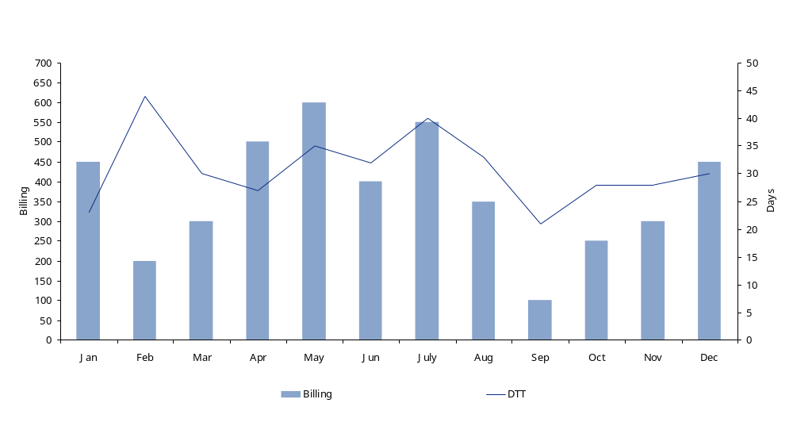
Diagnostic data analysis
Days to terms (DTT) (cont.)
[Chart title goes here]

Slide 38
Diagnostic data analysis
Weighted average terms (WAT)
Purpose
  Weighted Average Terms (WAT): Weighted Average of yearly sales by terms, The goal of this test is to analyse the company’s current best possible position and understand the main drivers by business with potential improvement opportunity. Measure of the average best possible payment term in days calculated by adding the billing per payment term weighted by total billing over a 12 month period.
Reporting level and reporting channel
  GM: With overview of Influenceable/Not influenceable.
  FD: And by business.
  FM: By collections stream.
Data scope
  All external customers (third parties only, NO INTERGROUP).
Minimum data requirement:
  Calculated on Paid invoices:
    Invoice number;
    Invoice amount;
    Customer code;
    Invoice Date;
    Invoice Due date;
    Customer group;
Calculation
  SUM for all invoices by the dimensions defined in the reporting level and channel of:
  (Invoice due date-Invoice date)*(Invoice Amount)
    Calculated by month for the last 12 months and by year rolling.
Frequency
  Every month end closure.
Benefits
  High level estimate of DTT, often used to understand BPDSO when terms and calculation of days for BPDSO are misleading and when transaction level data is unavailable.

Slide 39
Diagnostic data analysis
Weighted average terms (WAT) (cont.)
Weighted average terms (WAT)
Payment code | Method | Payment terms | Average days from invoice date | Sales value (€) | % | Weighted average terms
A1 | Cheque | 30 days | 30 | 1,000,000 | 3% | 1.0
A2 | Cheque | 30 EOM | 30 | 2,000,000 | 7% | 2.1
A3 | Cheque | 60 days | 60 | 500,000 | 2% | 1.0
DD1 | Direct debit | 30 days | 30 | 10,000,000 | 34% | 10.3
DD2 | Direct debit | 30 EOM | 30 | 5,000,000 | 17% | 5.2
DD3 | Direct debit | 60 days | 60 | 2,000,000 | 7% | 4.1
DD4 | Direct debit | 60 EOM | 60 | 500,000 | 2% | 1.0
T1 | Transfer | 15 days | 15 | 1,000,000 | 3% | 0.5
T2 | Transfer | 30 days | 30 | 5,000,000 | 17% | 5.2
T3 | Transfer | 30 EOM | 30 | 2,000,000 | 7% | 2.1
Total |  |  |  | €29,000,000 | 100% | 32.6 days
Example Data only

Slide 40
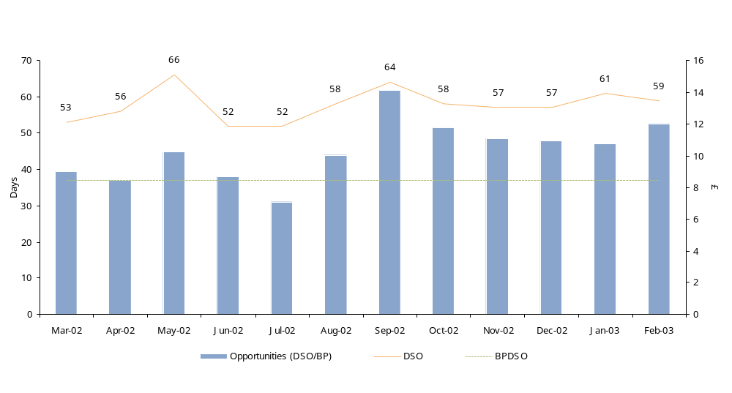
DSO v BPDSO performance
DSO/BPSO: Performance gap
Average BPDSO = 37
Example Data only

Slide 41
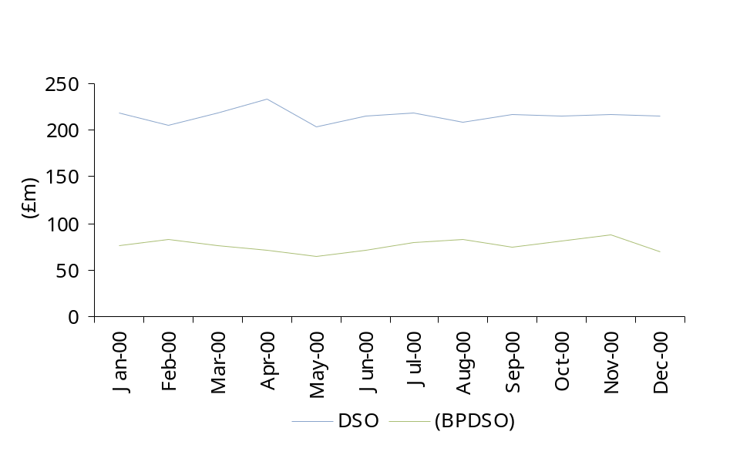
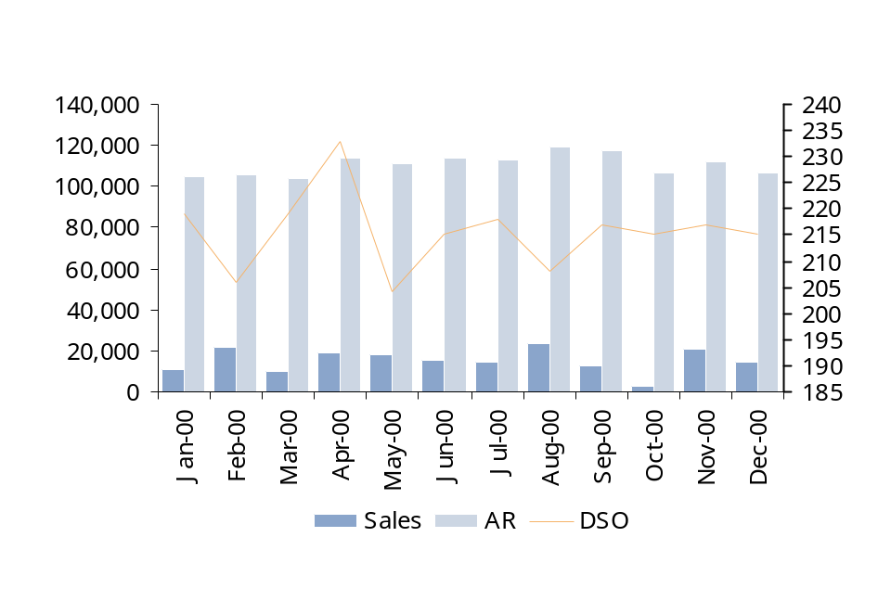
Diagnostic data analysis
DSO and BPDSO (alternative presentation)
DSO vs BPDSO
Receivable vs sales vs DSO
Example Data only

Slide 42
3. DUO / DAO

Slide 43
Diagnostic data analysis
Days unbilled outstanding (DUO)
Purpose
  Days of Unbilled Outstanding (DUO): The value of the third-party debtor balance only accounting for accrued / unbilled revenue not yet invoiced at a certain time, in terms of number of days of third-party sales giving the average number of days that customers take to pay.
Reporting level and reporting channel
  GM: With overview of Influenceable/Not influenceable.
  FD: by business.
  FM: By collections stream.
Data scope
  All external customers (third parties only, NO INTERGROUP).
Data requirement:
  Net external sales plus sales tax.
  Accrued receivable (unbilled) at month end for external sales plus sales tax.
Calculation
  Unbilled revenue / sales x 100
Frequency
  Every month end closure.
Benefits
  A measure of the efficiency of the invoicing cycle.
  By performing this each month and monitoring the evolution of unbilled revenue, it can be seen if there is a trend which needs to be addressed.

Slide 44
Diagnostic data analysis
Days unbilled outstanding DUO (cont.)
DUO calculation represents how many days of sales are in the unbilled revenue, and is calculated with the count back method by exhausting back the total value of the not yet billed revenue over the value of the current and previous months’ sales until all the debt is matched against the sales.
Data explained
Debt to be exhausted with count back method Value Debt to be exhausted with count back method (b): |  | Total outstanding Debt on revenue not yet billed ledger 25,000
Month | Days in a month (g) |  |  | Sales (a) | Debt to be still exhausted from previous months (c) | Amount exhausted against monthly sales (d) | Remaining debt still to be exhausted with previous months’ sales (e) | Days of sales proportional by the amount exhausted against the monthly sales amount (f)
 |  |  |  |  | For initial month is (b) otherwise it is (e) for the previous month | If the amount of debt that need to be exhausted (c) is greater than the relative monthly sales (a), the full month’s sales are exhausted against the debt. Otherwise only the remaining debt will be exhausted (c) | Debt to be still exhausted from previous months less the amount exhausted against monthly sales (c) – (d) | Amount exhausted against monthly sales over sales times the days in the specific months (d)*(g)/(a)
December | 31 |  | 12,500 |  | 25,000 | 12,500 | 27,500 | 31
November | 20 |  | 10,250 |  | 12,500 | 10,250 | 17,250 | 20
October | 31 |  | 11,000 |  | 2,250 | 2,250 | 0 | 6.3
September | 30 |  | 11,250 |  | 0 | 0 | 0 | 0
Total DUO (sum of column (f) |  |  |  |  |  |  |  | 67.3
Starting point
Calculation
explained
Remaining amount to be exhausted
Exhausted amount Converted in days
Sample data
Debt compared with sales to determine exhausted amount
Note: last month remaining debt is less than the monthly sales

Slide 45
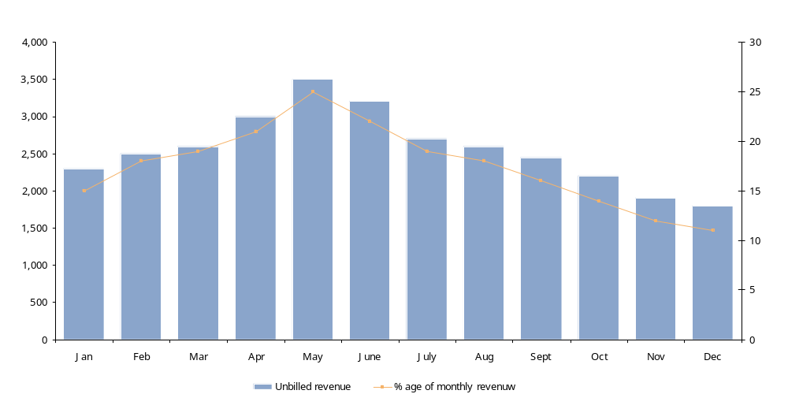
Diagnostic data analysis
Days unbilled outstanding (cont)
Example Data only

Slide 46
4. Rollover analysis

Slide 47
Diagnostic data analysis
Rollover analysis
Purpose
  A variation on the Aged Debt Profile. Gives the value of invoices in the ageing categories as a percentage of the value of invoices in the previous month and in the previous category – i.e. how much has 'rolled over' from one ageing category to the next. Used to determine collections performance per ageing bucket and to evaluate which receivables may be heading towards problems in collectibility.
Reporting level and reporting channel
  FM: By collections stream
Data scope
  All external customers (third parties only, NO INTERGROUP).
Data requirement:
  Total Accounts receivable ledger (showing due date for each debt):
    Add sales tax; and
    Subtract provisions.
Calculation
  See following pages for example calculations.
  Rollover = percentage of debt carried from one month to the next by aging bucket.
Frequency
  Every month end closure.
Benefits
  This calculation provides a measure of efficiency of the credit control department. Ideally, no amount should move from current to overdue and then from one overdue bucket to the next. As the debt rolls over in later buckets (eg 60 or 90 days overdue) it gives a good indication of where problems in collectibility lay.

Slide 48
Diagnostic data analysis
Rollover analysis
Calculation
  The data for this calculation is provided overleaf.
  September’s rollover calculation is based on data for August and September.
  To calculate September’s rollover from current to 1-30 days overdue the calculation is as follows:
    September 1-30 bucket / August current
    ie 9,160,980 / 63,591,567
    = 14.4%
  To calculate September’s rollover from 1 -30 into the 31-60 day overdue bucket, the calculation is as follows:
    September 31 – 60 bucket / August 1-30 bucket
    Ie 7,464,241 / 13,718,420
    = 54.4%
  In the example calculation overleaf it can be seen the company’s credit control department is relatively successful in collecting the current items but find it more difficult to stop the debt from ageing thereafter although, as time progresses there is an improvement in preventing debts ageing.

Slide 49
Receivables management
Rollover analysis
Rollover analysis
 | AR | Current |  | 1 to 30 |  | 31 to 60 |  | 61 to 90 |  | 91 to 120 |  | Over 120 | Total overdue | % overdue
August | 89,149,989 | 63,591,567 |  |  | 13,718,420 |  | 6,795,641 |  | 3,463,906 |  | 1,883,583 | 8,071,022 | 33,932,572 | 38%
Rollover |  |  |  | 14% |  | 54% |  | 52% |  | 77%
September | 92,860,036 | 64,404,870 |  |  | 9,160,980 |  | 7,464,241 |  | 3,528,768 |  | 2,653,682 | 8,842,389 | 31,650,060 | 34%
Rollover |  |  |  | 13% |  | 59% |  | 51% |  | 76%
October | 90,272,983 | 63,549,373 |  |  | 8,601,686 |  | 5,441,101 |  | 3,781,345 |  | 2,694,899 | 10,052,840 | 30,571,871 | 34%
Rollover |  |  |  | 12% |  | 57% |  | 71% |  | 63%
November | 84,802,015 | 57,285,402 |  |  | 7,372,301 |  | 4,864,416 |  | 3,869,866 |  | 2,397,972 | 10,945,134 | 29,449,689 | 35%
Rollover |  |  |  | 15% |  | 35% |  | 47% |  | 51%
December | 82,032,276 | 58,364,841 |  |  | 8,317,903 |  | 2,582,732 |  | 2,273,953 |  | 1,989,807 | 11,071,067 | 26,235,462 | 32%
Rollover |  |  |  | 10% |  | 67% |  | 71% |  | 63%
January | 81,554,193 | 57,557,015 |  |  | 6,038,391 |  | 5,559,336 |  | 1,837,513 |  | 1,441,656 | 11,830,195 | 26,707,090 | 33%
Rollover |  |  |  | 11% |  | 32% |  | 40% |  | 50%
February | 79,179,619 | 59,456,480 |  |  | 6,110,111 |  | 1,940,851 |  | 2,239,472 |  | 914,372 | 10,456,803 | 21,661,609 | 27%
Rollover |  |  |  | 11% |  | 28% |  | 79% |  | 57%
March | 79,419,399 | 61,627,460 |  |  | 6,594,340 |  | 1,684,536 |  | 1,526,878 |  | 1,285,316 | 9,423,724 | 20,514,795 | 26%
Rollover |  |  |  | 8% |  | 45% |  | 38% |  | 58%
April | 81,420,889 | 64,045,922 |  |  | 4,885,241 |  | 2,948,848 |  | 640,746 |  | 878,309 | 9,774,607 | 19,127,752 | 23%
Rollover |  |  |  | 6% |  | 39% |  | 44% |  | 54%
May | 84,725,025 | 69,717,661 |  |  | 3,913,970 |  | 1,890,195 |  | 1,304,919 |  | 348,024 | 8,443,298 | 15,900,406 | 19%
Rollover |  |  |  | 7% |  | 56% |  | 52% |  | 32%
June | 86,362,873 | 70,930,890 |  |  | 4,996,437 |  | 2,207,157 |  | 978,270 |  | 419,691 | 7,739,139 | 16,340,695 | 19%
Rollover |  |  |  | 9% |  | 58% |  | 42% |  | 32%
July | 86,336,570 | 70,298,406 |  |  | 6,394,989 |  | 2,911,965 |  | 930,068 |  | 317,770 | 6,942,053 | 17,496,845 | 20%
Average | 84,842,989 | 63,402,490 |  | 11% | 7,175,397 | 48% | 3,857,585 | 53% | 2,197,975 | 56% | 1,435,424 | 9,466,023 | 24,132,404 | 27%
Example Data only

Slide 50
5. Customer segmentation

Slide 51
Diagnostic data analysis
Major debtor analysis
Purpose
  Analysis of the major customers.
  Follow-up focused on value of debt and due by age.
Reporting level and reporting channel
  FM (Credit Manager)
Data scope
  Customers representing 80% of receivables (by value) can be considered top customers.
Data requirement:
  Aging for top 80% customers.
Calculation
  None, review current aging and understand current major issues with the goal of determining:
    Possible block, delays in reaching benefits;
    Possible quick wins; and
    Current collection approach, process.
Frequency
  Weekly / monthly
Benefits
  By understanding the composition of the debtors ledger, this enables management and credit control teams to focus the collection attention on those customers that have the greatest cash impact.

Slide 52
Diagnostic data analysis
Major debtor analysis
Major debtor analysis
£000 | Current | 1-30 | 31-60 | 61-90 | 91-12 | 121-150 | 151-360 | >360 | Total
Customer A | 10,000 | 1,000 | 500 | 50 | 100 |  |  |  | 11,650
Customer B | 9,500 |  | 300 |  | 50 |  |  |  | 9,850
Customer C | 9,400 | 2,500 |  | 100 |  |  |  |  | 12,000
Customer D | 3,000 | 3,000 | 2,000 | 1,000 | 50 | 100 |  |  | 9,150
Customer E | 7,000 | 1,000 | 1,000 | 200 | 100 |  |  |  | 9,300
Customer F | 6,000 | 100 | 1,500 |  |  |  |  |  | 7,600
Total | 44,900 | 7,600 | 5,300 | 1,350 | 300 | 100 |  |  | 59,550
Example Data only

Slide 53
Customer Segmentation
Payment Performance
Categories are defined by gap between DTC and DTT i.e. for good payers DTC-DTT <5 days
Different customers require different collection strategies
Best customers
Target for additional revenue generation
Customise support
 | Payment performance
 | Green (Good payers) |  | Amber (Average payers) |  |  | Red (Bad Payers)
A | # of customers | 125 | # of customers | 240 |  | # of customers | 61
 | # of invoices | 13% | # of invoices | 60% |  | # of invoices | 7%
 | Billing | 15% | Billing | 56% |  | Billing | 8%
 | Average AR | 8% | Average AR | 54% |  | Average AR | 17%
 | DTC DTT | 22 19 | DTC DTT | 41 31 |  | DTC DTT | 83 44
 | Average Invoice | 1,414 | Average Invoice | 1,159 |  | Average Invoice | 1,372
B | # of customers | 306 | # of customers | 253 |  | # of customers | 107
 | # of invoices | 4% | # of invoices | 4% |  | # of invoices | 2%
 | Billing | 7% | Billing | 6% |  | Billing | 3%
 | Average AR | 3% | Average AR | 6% |  | Average AR | 6%
 | DTC DTT | 20 16 | DTC DTT | 40 30 |  | DTC DTT | 93 50
 | Average Invoice | 2,077 | Average Invoice | 1,671 |  | Average Invoice | 1,649
C | # of customers | 6,899 | # of customers | 1,532 |  | # of customers | 1,356
 | # of invoices | 5% | # of invoices | 2% |  | # of invoices | 2%
 | Billing | 4% | Billing | 2% |  | Billing | 1%
 | Average AR | 1% | Average AR | 2% |  | Average AR | 3%
 | DTC DTT | 8 4 | DTC DTT | 45 33 |  | DTC DTT | 256 48
 | Average Invoice | 954 | Average Invoice | 972 |  | Average Invoice | 731
 |  |  |  |  | D | # of customers | (5,390)
 |  |  |  |  |  | # of invoices | (1)%
 |  |  |  |  |  | Billing | NA
 |  |  |  |  |  | AR | NA
 |  |  |  |  |  | Average DBO | NA
Highest exposure
Target for T&C negotiation and Disputes task force
Small customers, low risk
Candidate for alternative channel
Candidates for process automation (e-pay or e-bill, web, Direct Debit)
Highest risk of write-offs
Candidate for clean-up and change of channel
A – 80% of Revenue Total customers 16,269
B – 95% of Revenue Total invoices 250,672
C – Others Billing $428,399,380
D – No sales or credits AR $308,005,238
Example Data only

Slide 54
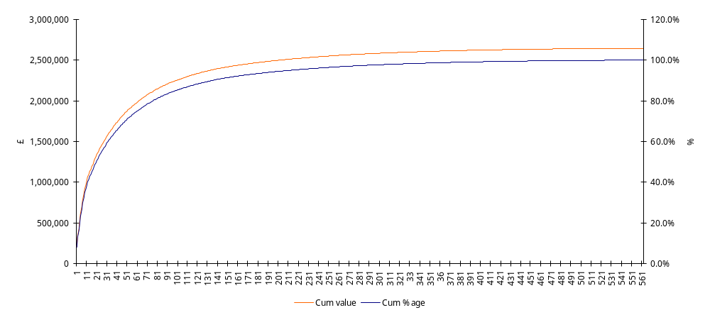
Diagnostic data analysis
Customer pareto analysis (alternative presentation)
  For maximum impact, the largest 76 customers should be contacted rather than all 562.
Traditional – CUM AR
211 customers make 95% of GR
76 customers make 80% of AR
Example Data only

Slide 55
6. Discount terms analysis

Slide 56
Discount terms analysis
Purpose
  Analyse value of each discounted terms compared to cash discount value to understand current trade off and effective presence of a group strategy
Reporting level and reporting channel
  FD SD by customer channel.
Data scope
  Third parties customers.
Data requirement:
  Spend by customer by term].
  N invoices by customer by term.
Calculation
  Calculate value in days of each % discounted term compared to net option.
Frequency
  Monthly.
Benefits
  By company different cash discount terms it is possible to identify potential misalignment between days and cash discount between the different terms and allocate potential cash/cost benefits if terms would be aligned.

Slide 57
Discount terms analysis
Discount terms analysis
Terms | Discount | Days granted per percentage point | Received | Cost benefit | Discount
5 days 3%, 30 days net | 3% | 5 | 1,000 | 25.1,000 = 68.5 365 | 0.02 x 1,000 = 20
3 days 4%, 30 days net | 7% | 7 | 500 | 23.900 = 31. 205 | 0.03 x 500 = 15
20 days 3%, 30 days net | 4% | 3 | 800 | 27.800 = 59.2 365 | 0.02 x 800 = 16
20 days 2%, 30 days net | 3% | 5 | 200 | 25.200 = 13.7 365 | 0.01 x 200= 2
30 days 2%, 65 days net | 2% | 30 | 3,000 | - | -
15 days 2%, 30 days net | 1% | 8 | 200 | 22.200 = 12.1 365 | 0.01 x 200 = 2
Total |  |  |  | 184.0 | 55
Example Data only

Slide 58
7. Invoicing profile

Slide 59
Diagnostic data analysis
Invoicing profile
Purpose
  Annual, monthly or weekly high variation of billing. Reflects frequency of invoicing.
Reporting level and reporting channel
  FD SD Total company and by customer segment/channel.
Data scope
  All third parties invoices.
Data requirement:
  Number of Corrected invoices.
  Total number of invoices.
Calculation
  Sales focusing on achieving targets at month end if usually the main cause of the Skew.
  Skew might also indicate lack of quality in the billing process.
  Best Practice Indication : No skew if possible = regular billing over a period.
  A poor performance may be due to the system, a lack of competence or training, or poor quality of information (received from the dispatch department, sales administration etc…). Causes must be analysed by sector of responsibility.
Frequency
  Monthly, weekly and/or daily.
Benefits
  By understanding when invoices are being raised it may indicate if invoicing is being blocked or could be accelerated. Acceleration of invoicing could lead to earlier receipts of payments from customers.

Slide 60
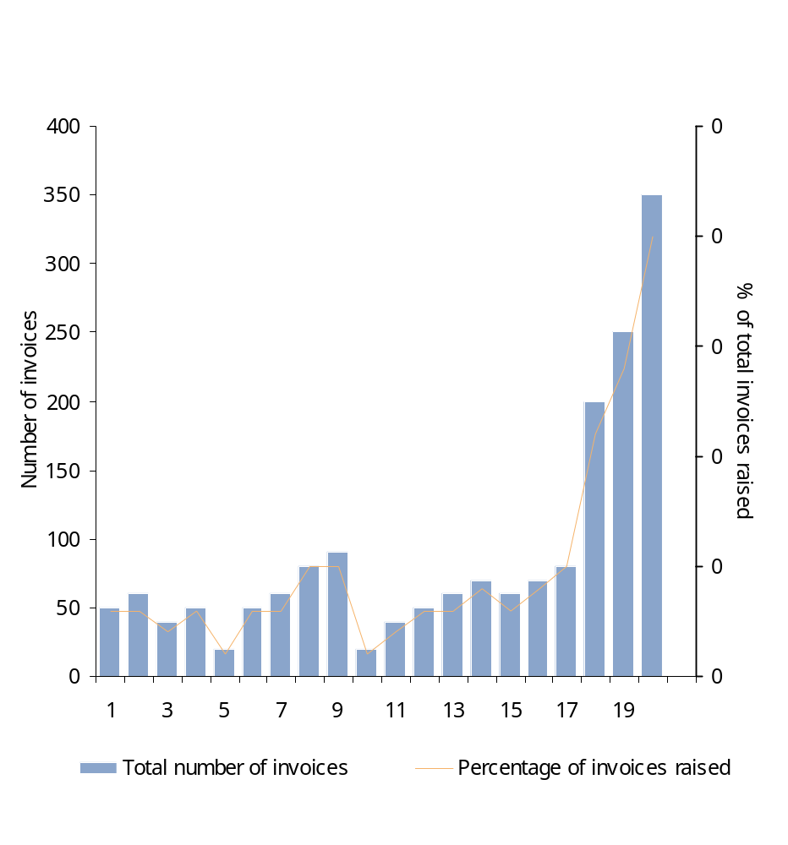
Diagnostic data analysis
Invoicing profile (cont.)
Invoice skew volume analysis
This test can also be performed for value of invoices raised as well as volume
Example Data only

Slide 61
8. Credit note ratio and cause analysis

Slide 62
Diagnostic data analysis
Credit notes cause analysis
Purpose
  Credit notes value and volume by cause. Its purpose is to identify key reasons for raising credit notes and their cause.
Reporting level and reporting channel
  FM: By collections stream.
Data scope
  All external customers (third parties only, NO INTERGROUP).
Data requirement:
  Credit notes showing reason and value.
Calculation
  Credit note reason as a percentage of total for volume and value.
Frequency
  Every month end closure.
Benefits
  By understanding the cause of credit notes being issued it should be possible to identify ways to stopping the issue arising in the future.

Slide 63
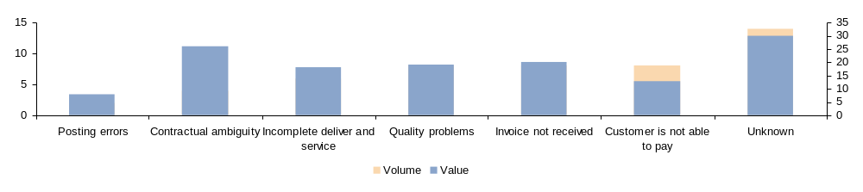
Receivables management
Credit notes cause analysis and credit note volume and value by type
Causes of overdue invoices
Period: Date:
 | Volume of invoices |  | Value (000s)
Causes | Volume | % | Value | %
Posting errors | 2 | 4% | 8 | 6%
Contractual ambiguity | 4 | 8% | 26 | 19%
Incomplete deliver and service | 6 | 12% | 18 | 13%
Quality problems | 8 | 16% | 19 | 14%
Invoice not received | 8 | 16% | 20 | 15%
Overdue not due to dispute
Customer is not able to pay | 8 | 16% | 13 | 10%
Unknown | 14 | 28% | 30 | 22%
Total | 50 | 100% | 134 | 100%
Volume and value of credit notes by cause
Example Data only

Slide 64
9. Dispute analysis
(delay, throughput, root cause)

Slide 65
Diagnostic data analysis
Dispute cause analysis and resolution delays analysis
Purpose
  To measure the volume and value of disputes by reason and average age of disputes.
Reporting level and reporting channel
  FM: By collections stream.
Data scope
  All external customers (third parties only, NO INTERGROUP).
Data requirement:
  Dispute list showing type and value.
  Date raised and resolved for all disputes.
Calculation
  Dispute type as a percentage of total for volume and value.
  Average age in days of all disputes.
  Surfacing delay in days = dispute raised date – invoice date.
  Resolution delay in days = dispute resolved date – dispute raised date.
Frequency
  Every month end closure.
Benefits
  By understanding the cause of dispute being raised it should be possible to identify ways to stopping the issue arising in the future.
  Provides analysis to identify the types of dispute, how long it takes to resolve, how long a dispute takes to be identified.

Slide 66
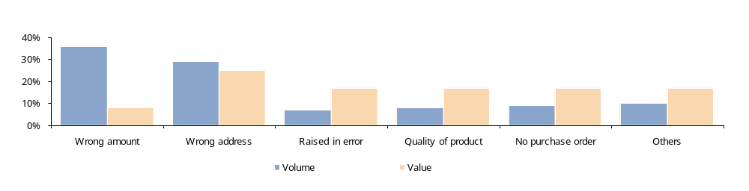
Receivables management
Dispute cause analysis and resolution delays analysis
Volume and value of disputes by dispute type
Example Data only

Slide 67
10. Sales ledger by nature

Slide 68
Diagnostic data analysis
Sales ledger by nature
Purpose
  Breakdown of accounts receivables into follow-up categories (promise to pay, under dispute, financial difficulties, legal, etc). Provides visibility of the status of outstanding items in the ledger. Used to evaluate collections coverage of the balance sheet.
Reporting level and reporting channel
  FM: By collections stream.
Data scope
  All external customers (third parties only, NO INTERGROUP).
Data requirement:
  Value of outstanding invoices per documented collections status.
Calculation
  Total of invoice value as per collections status (promise to pay, under dispute, etc), percent of total coverage and percent of overdue covered by collections activity.
Frequency
  Weekly or bi-weekly or monthly (as per collections cycle).
Benefits
  Allows analysis of the sales ledger by type of issue. Provides collectors and management with an indication of the problems within the overdue accounts of a ledger.

Slide 69
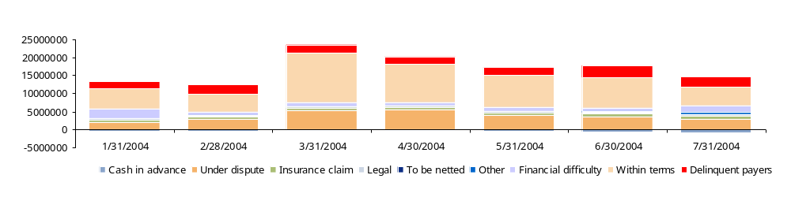
Receivables management
Sales ledger by nature
AR by nature follow-up
Date |  | Cash in advance | Under dispute | Insurance claim | Legal | To be netted | Other | Financial difficulty | Within terms | Delinquent payers
31/01/2004 |  | 389,736 | 2,081,521 | 681,166 | 359,841 | - | 78,805 | 2,710,936 | 5,363,119 | 2,000,132
28/02/2004 |  | 449,736 | 2,884,585 | 681,166 | 359,841 | - | 33,852 | 985,085 | 4,936,868 | 2,567,879
31/03/2004 |  | 225,767 | 5,435,323 | 681,166 | 359,841 | 4,457 | 60,737 | 1,033,463 | 13,733,240 | 2,212,333
30/04/2004 |  | 225,767 | 5,650,149 | 681,166 | 359,841 | 26,447 | 60,737 | 891,585 | 10,409,059 | 1,987,098
31/05/2004 |  | 437,913 | 3,963,751 | 802,827 | 359,841 | 88,161 | 12,993 | 981,669 | 8,759,813 | 2.234.765
30/06/2004 |  | 499,182 | 3,647,426 | 802,827 | 359,841 | 88,231 | 259,984 | 896,390 | 8,414,035 | 3,222,111
31/07/2004 |  | 814,570 | 3,026,533 | 802,300 | 359,841 | 69,692 | 624,201 | 1,772,088 | 5,112,077 | 2,873,345
AR by nature code evolution (€)
Example Data only

Slide 70
11. Customer payment method analysis

Slide 71
Diagnostic data analysis
Customer payment method
Purpose
  An analysis of the customer base and how they pay. Its purpose is to identify all payment mechanisms used by the customer base e.g. cash, cheque, automatic bank deduction, letter of credit, credit card, post dated cheques etc. Certain payment methods are more likely to lead to differences between the DSO and the BPDSO e.g. cheques.
Reporting level and reporting channel
  FM: By collections stream.
Data scope
  All external customers (third parties only, NO INTERGROUP).
Data requirement:
  Total invoicing by payment method.
Calculation
  Percentage of total invoicing per payment method in volume and value. Total number of customers using each payment method.
Frequency
  Every month end closure.
Benefits
  By understanding the payment type, customers could be encouraged to use a faster method of payment (eg bank transfer) which could potentially reduce the gap between DSO and BPDSO.

Slide 72
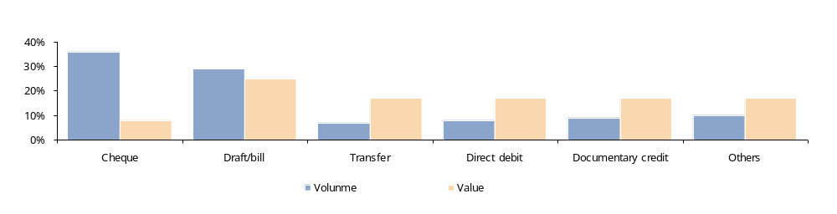
Receivables management
Customer payment method
Billings by payment means (volume and value of invoices by payment means)
 |  |  | Volume |  |  |  | Value (000s)
Payment means | Number of customers |  | Volume | Cumulative volume | % | Cumulative % | Value | Cumulative value | % | Cumulative %
Cheque | 200 |  | 50 | 50 | 36% | 36% | 8 | 8 | 8% | 8%
Draft/bill | 500 |  | 40 | 90 | 29% | 66% | 26 | 34 | 25% | 32%
Transfer | 79 |  | 10 | 100 | 7% | 73% | 18 | 52 | 17% | 49%
Direct debit | 1 |  | 11 | 111 | 8% | 81% | 18 | 70 | 17% | 66%
Documentary credit | 23 |  | 12 | 123 | 9% | 90% | 18 | 88 | 17% | 83%
Others | 10 |  | 14 | 137 | 10% | 100% | 18 | 106 | 17% | 100%
Total | 813 |  | 137 |  | 100% |  | 106 |  | 100%
Volume and value of invoices by payment means
Example Data only

Slide 73
12. Credit Limit Effectiveness Coverage

Slide 74
Diagnostic data analysis
Credit limit effectiveness
Purpose
  Performance measurement comparing credit limit amount to the total A/R balance,
  Comparison of customers with effective and ineffective (i.e. : too high or too low) Credit Limit (vol./%).
Reporting level and reporting channel
  MD at total group.
  FD and AS at major customer channel/ segment level.
Data scope
  Third parties customers.
Data requirement:
Monthly
  Total exposure includes : A/R, unbilled, and Work in Progress.
  Credit limit value.
Calculation
  Best Practice indication : if credit limit is >+15% or <-15% to total exposure, credit limit setting is ineffective.
Frequency
  This should be reviewed over the last year of trading.
Benefits
  By understanding how much the credit limit is covering the current business performance, is possible to asses potential issues in over exposure based on a too generous setting of the limit or potential revenue loss due to missed sales, or cash delays and consequent extra workload due to a continuous breach of the limit.

Slide 75
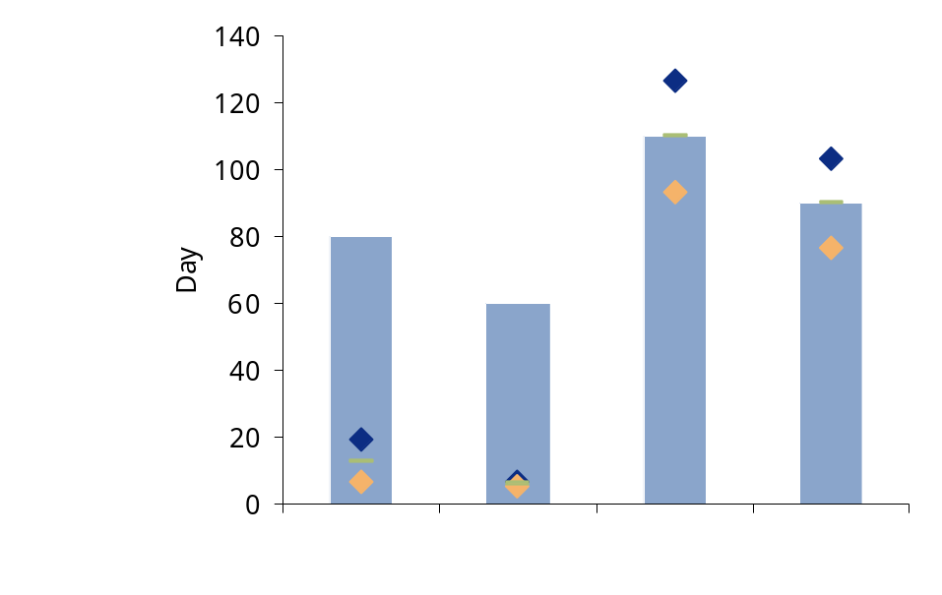
Diagnostic data analysis
Credit limit effectiveness
Credit limit effectiveness
○ Exposure | 80 | 60 | 110 | 90
❐ (+15%) upper limit | 9.2 | 6.9 | 126.5 | 103.5
 (-15%) lower limit | 6.8 | 5.1 | 93.5 | 76.5
○ Value credit limit | 13 | 6 | 110 | 90
Example Data only

Slide 76
Diagnostic data analysis
Credit limit violation
Purpose
  Measure of the number of times credit limits are exceeded without impact (frozen orders) compared to all credit limits.
Reporting level and reporting channel
  FD SD and FM (credit manager), reporting by customer channel.
Data scope
  Measurement of customers with exceeded credit limit with no action undertaken to solve the problem.
Data requirement:
  Value of order exceeding credit limit on a monthly basis.
Calculation
  Causal analysis of credit limit violation must be carried out. For example commercial decision, credit limit ineffective or ignored.
  Analyse total Year to date and Monthly values.
  Understand average resolution times.
Frequency
  Monthly.
Benefits
  Having better understanding of breaches provide an insights on how to tackles credit limit redesign/dispute management collection process review

Slide 77
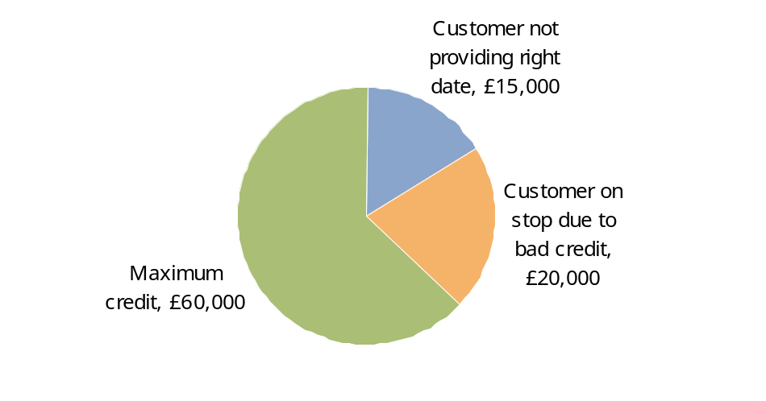
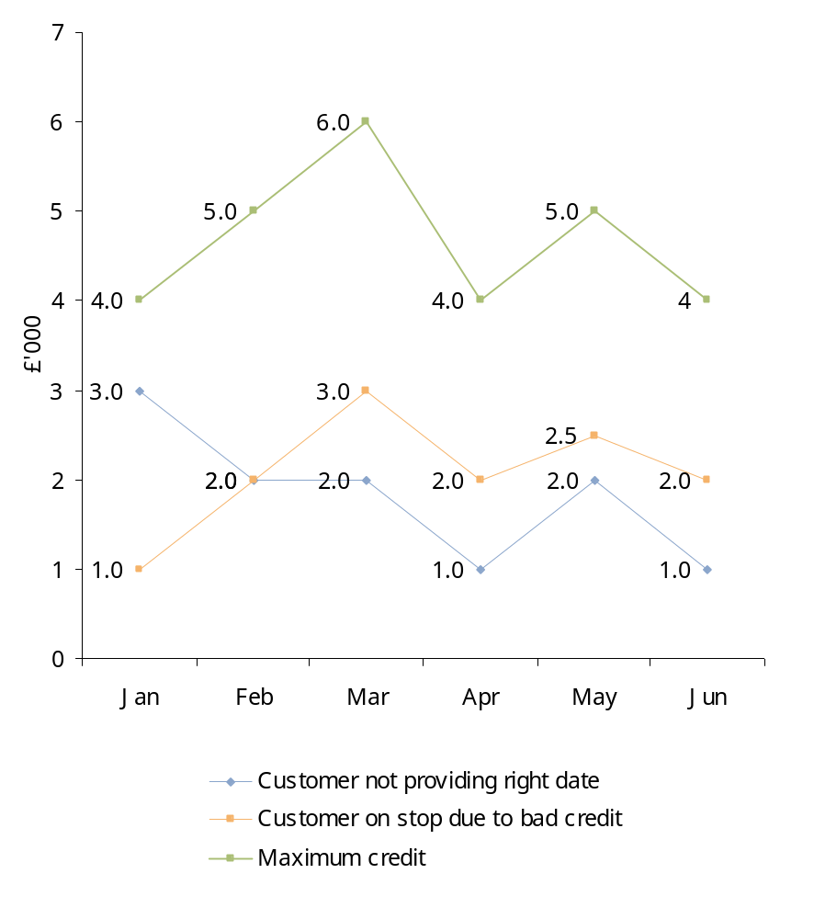
Diagnostic data analysis
Credit limit violation
Credit limit breaches analysis
Main reasons for credit limit breaches
Example Data only

Slide 78
13. Block Analysis

Slide 79
Invoice block analysis
Objective
  Understand current distribution of invoices and customers around invoice bucket analysis.
  Reporting level and reporting channel
  FD SD by customer channel.
Data scope
  Third parties customers.
Data requirement
  Invoices detailed data by customer for 12 months:
    Invoice N;
    Invoice amount;
    Customer code.
Calculation
  Group invoices.
  Frequency
  Monthly.
Benefits
  Provides a quick overview on how total invoices by volume and value are distributed among a predefined sent of interval amount. This analysis can be used to determine is there could opportunities in grouping invoices, or the if the value issues in collection due to high percentage of small invoices.

Slide 80
Invoice block analysis (cont.)
Invoice value | Turnover (000) | Turnover % | Documents (000) | Doc %
> £15 000 | 800,000.00 | 14% | 15 | 1%
£10,000 - £15, 000 | 500,000.00 | 9% | 45 | 2%
£5,000 - £10,000 | 1,200,000.00 | 22% | 220 | 8%
£1, 000 - £5, 000 | 2,500,000.00 | 45% | 700 | 25%
£500 - £1,000 | 400,000.00 | 7% | 650 | 23%
£100 - £500 | 100,000.00 | 2% | 500 | 18%
£0 - £100 | 50,000.00 | 1% | 700 | 25%
Totals | 5,550,000.00 | 100% | 2,830.00 | 100%

Slide 81
Appendix
Overview of Approach for Release of Working Capital Opportunities

Slide 82













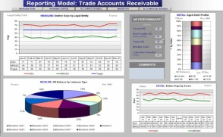
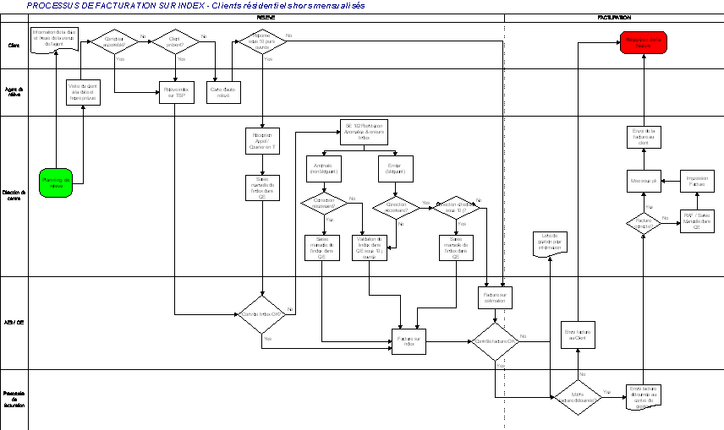
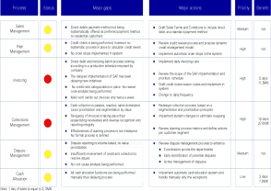
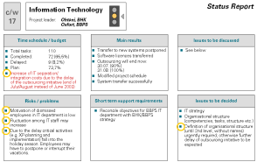
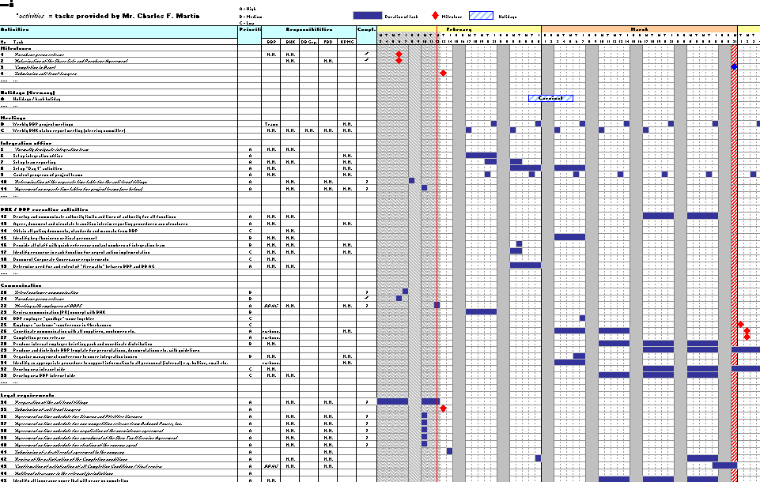
Overview of Approach for Release of Working Capital Opportunities
KPMG’s approach focuses on understanding cash and working capital performance from both an analytical as well as from an operational point of view.
Assess
process, policy
and organisation
Identify gaps to better practice
Evaluate root causes
Quantify
Improvement potential for
short to
medium term
Prepare
action plan
Interviews
4
Actual
performance
Analyze systems, tools and information accuracy
Assess Cash Flow and Working Capital performance
1
Workshops
Establish
performance
baseline
Assess key performance drivers and root causes
2
3
Best Possible
performance
Analyze
reporting, KPIs,
and incentives
Data analysis
Analyse
staffing levels, and
competences.
HR
Example Deliverables
Performance review
and target setting
Process maps
Best practice
gap analysis
Detailed
recommendations
Action planning

